Slide 1

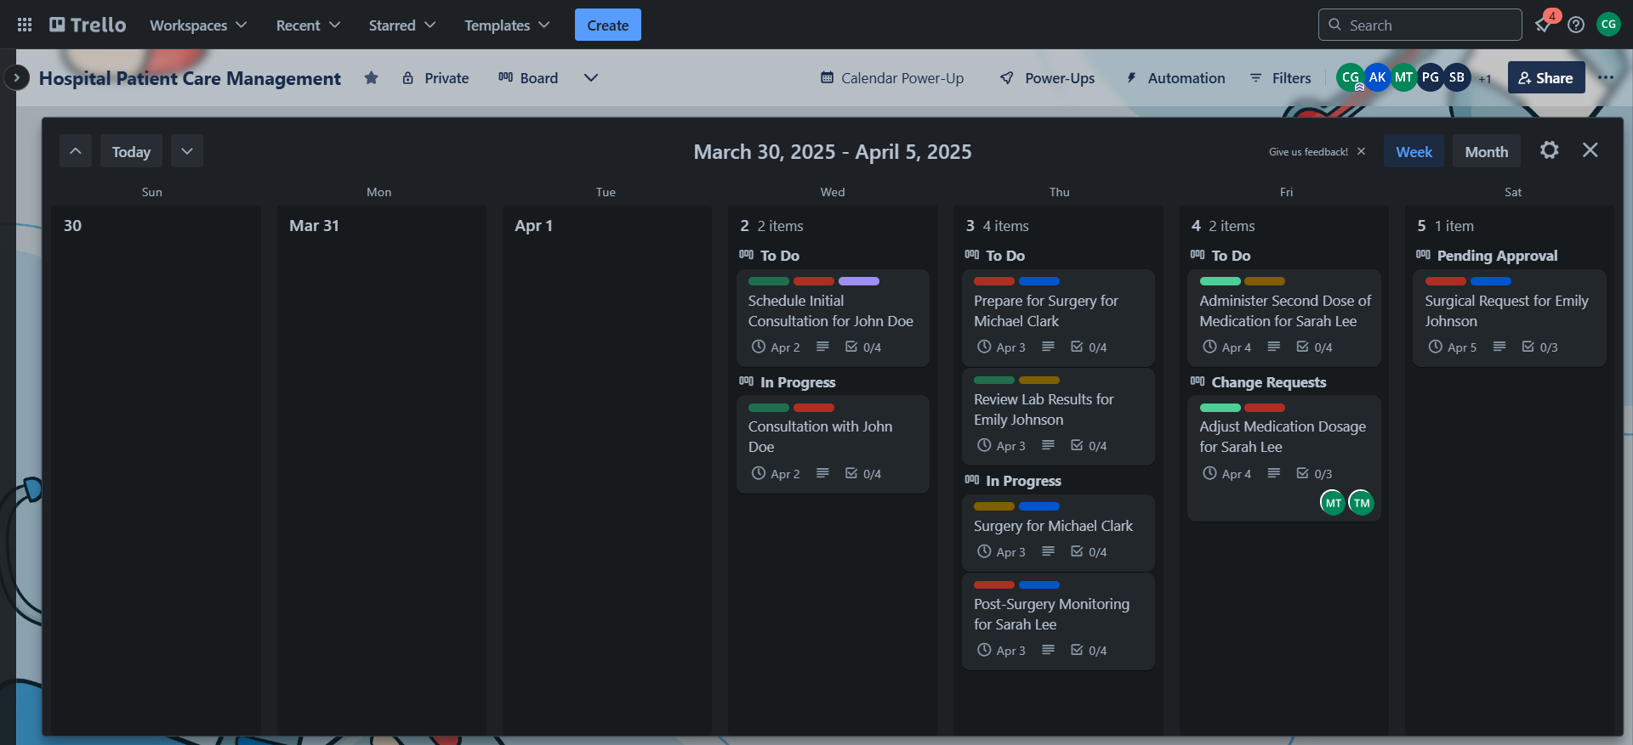
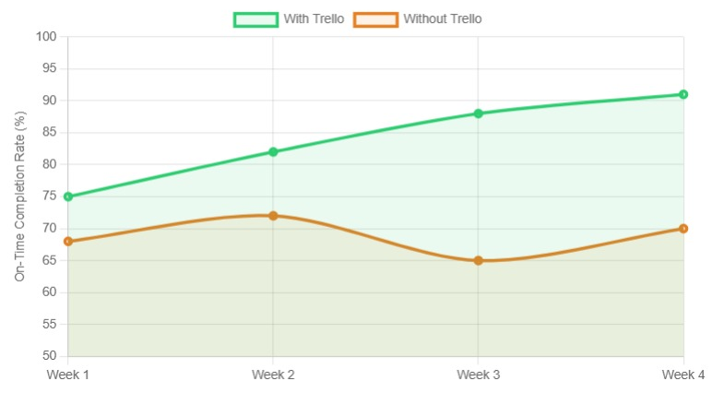
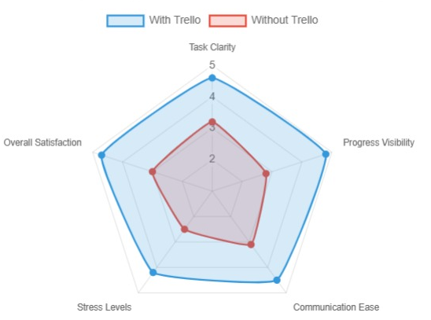
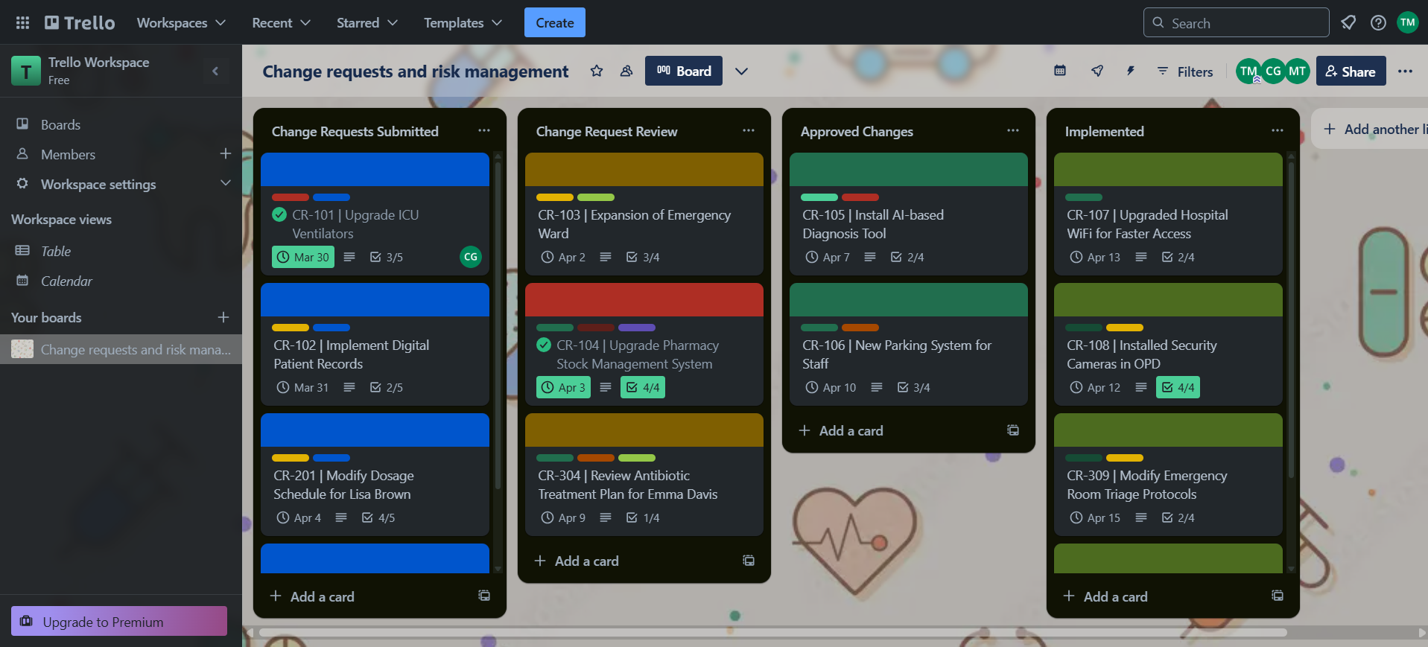
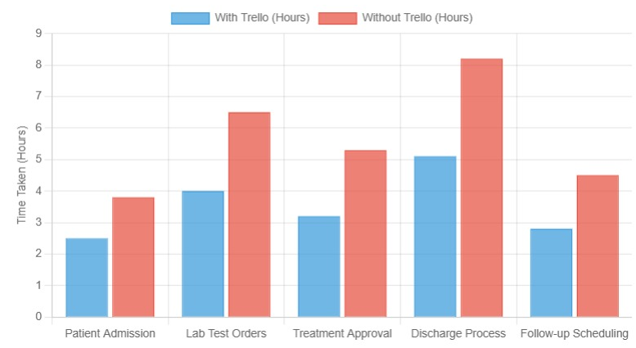
Somaiya Vidyavihar University Faculty of Engineering & Technology
K J Somaiya School of Engineering
Name of Program: BTech IT
Title: Evaluating the Effectiveness of Trello in Managing Software Projects: A Case Study
Authors: Tanisha Mangaonkar, Aastha Kataria, Prachi Gandhi, Chandana Galgali, Mahek Thakkar, Samrudhi Bhat
Abstract
Modern software projects face significant challenges in task coordination, resource allocation, and team collaboration, with traditional management methods often proving inefficient. This study evaluates Trello’s efficacy in software project management through a structured case study and comparative analysis with industry-standard tools (Jira, Asana). Results demonstrate that Trello’s Kanban-based interface improves task transparency (23% improvement in on-time completion rates) and team communication for small-to-medium projects, while revealing key limitations like inadequate advanced reporting, lack of built-in time tracking, and limited scalability for complex Agile workflows.
Outcome: Trello improved task visibility and team communication, reducing delays by 28-38% and ensuring timely task completion.
Experiment 2: Software Change Request Management
Objective: Implement a structured process for managing software change requests using Trello.
Setup: A Trello board tracked change requests across hospital departments, with lists like “Proposed Changes,” “Under Review,” and “Completed” to manage the approval and implementation stages.
Outcome: Trello’s visual workflow and real-time updates enhanced collaboration, streamlining the software change management process and improving efficiency.
Methodology
The study used practical experiments simulating software project workflows, comparing Trello with Jira and Asana. Key metrics focused on task completion times, on-time task completion rates, team satisfaction, and communication improvements. The effectiveness of Trello was assessed by observing its real-time updates, task transparency, and overall team collaboration.
On-time Completion: The Trello cohort demonstrated a 23% improvement in on-time task completion, particularly in software change request management.
Team Satisfaction: Post-study surveys revealed that Trello improved task clarity, team communication, and stress levels, indicating positive impacts on team dynamics.
Challenges and Limitations
Scalability: Trello is less effective for larger, complex projects due to its simplicity.
Reporting: Lacks advanced reporting features for detailed tracking.
Time Tracking: Absence of built-in time tracking and task dependencies limits its use in large Agile workflows.
Introduction
In modern software development, effective project management is essential. Traditional methods such as manual tracking or face-to-face discussions often lead to confusion and delays. Digital tools like Trello, which utilize the Kanban methodology, simplify task management and encourage better team collaboration. This research examines Trello’s effectiveness in managing software projects, particularly its impact on team collaboration, task management efficiency, and overall project success.
Literature
Trello’s visual, simple, and flexible Kanban interface has made it popular among small teams and personal projects. However, it lacks advanced features required for large, complex projects, particularly in reporting and task dependencies. Compared to competitors like Jira and Asana, Trello is favored for its ease of use but falls short in more intricate project workflows. This study investigates how Trello measures up in managing software projects, with particular focus on efficiency gains and team collaboration.
Conclusion
Trello is an excellent tool for small-to-medium software projects, improving task management and team collaboration. However, it needs additional tools or integrations (like Jira or Asana) to handle larger, more complex projects. Despite its limitations, Trello’s simplicity, usability, and visual task management make it a powerful tool for lightweight project management.
Case Study
The research involved two practical experiments evaluating Trello’s impact on software project management:
Results and Discussion
Efficiency Gains: Experiment results showed that Trello users completed tasks 28-38% faster than those using traditional tools.
Publications/References
Ahmad, M. O., Markkula, J., & Oivo, M. (2023). "Kanban in software development: A systematic literature review." Journal of Software: Evolution and Process, 35(3), 2402-2426.
Rola, P., Kuchta, D., & Kopczyk, D. (2022). "Conceptual framework of visual project management." Journal of Industrial Information Integration, 25, 100246.
Experiment 1: Efficient Task Management and Collaboration
Objective: Analyze Trello's effectiveness in organizing and prioritizing tasks in a software development environment.
Setup: A Trello board was created to manage hospital patient care, with categories like “To Do,” “In Progress,” and “Completed” for tracking tasks such as consultations and surgeries.

